Slide 1
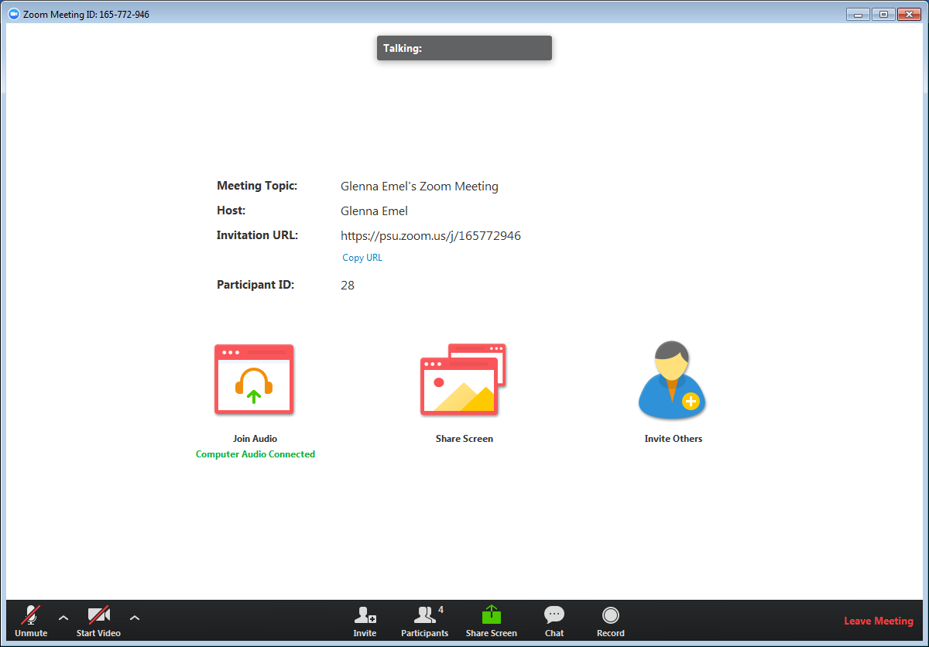
A menu bar containing participant tools appears at the bottom of the Zoom meeting. This menu bar will appear and disappear as you roll your mouse over the area.
Use the buttons in the lower left to Mute/Unmute and Start/Stop Video. Click the up arrow ^ to select a different microphone, speaker, or camera.
Click Chat to send a message to your instructor or the entire class. Click Participants to access the nonverbal feedback icons. [this menu may vary depending on the Zoom settings]
Welcome!

Slide 2
Please remember:
This session may be recorded
If possible, use earbuds or a headset
Mute your microphone when you aren’t speaking
Call from your phone if your microphone/speaker on your computer is not connecting
[customize based on how you want students to interact with you during a meeting] Use the chat feature, use the Participants bar to ‘Raise hand’, or turn on your microphone to ask a question

